Slide 1
201812
Tungsten Tip Etching
Lee Jong Geon

Slide 2
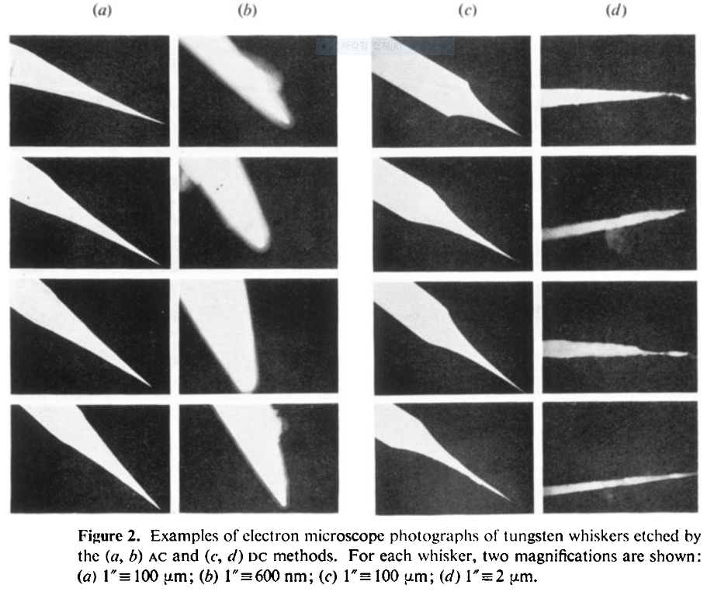
1978-J. Phys. D: Appl. Phys.-11-A comparison of AC and DC electrochemical etching techniques for the fabrication of tungsten whiskers (G. J. Edwards and P. R. Pearce)
AC
DC

Slide 3
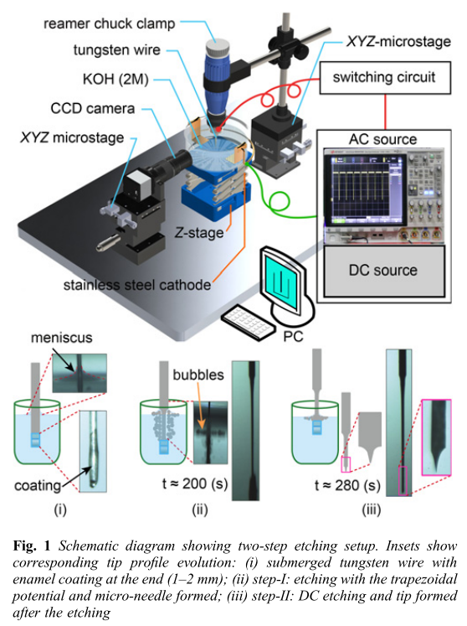
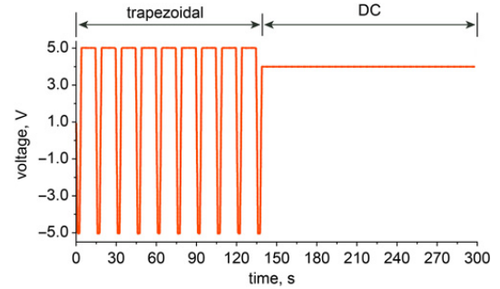
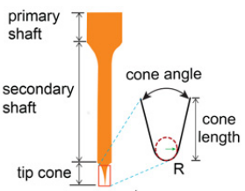
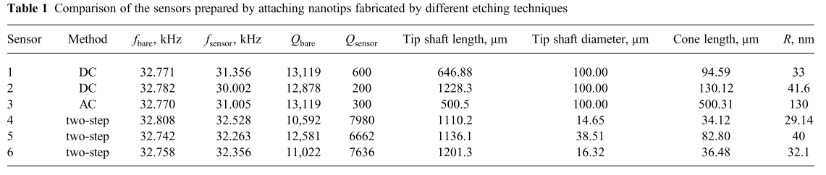
2018-Micro&Nano Letters-13,8-Electrochemical etching of lightweight nanotips for high quality-factor quartz tuning fork force sensor: atomic force microscopy applications (Danish Hussain, Jianmin Song, Hao Zhang, Xianghe meng and Hui Xie)
Two step
Primary shaft diameter: 10–40 μm
Length: 2–5 mm
Fabricated with high success rate (∼80%).
High Q-factor

Slide 4
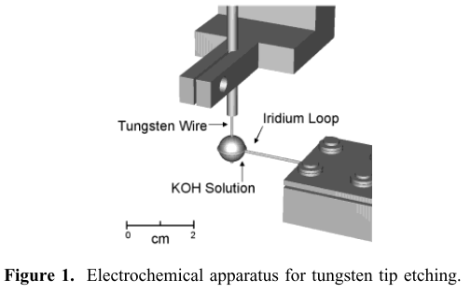
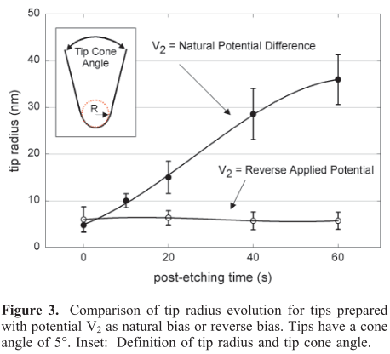
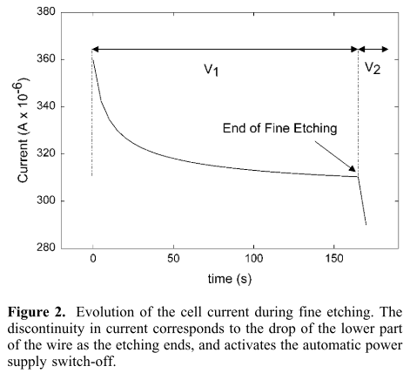
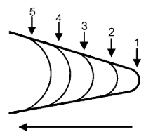
2002-Nano Letters-2,3-Reproducible Electrochemical Etching of Tungsten Probe Tips (Olivier L. Guise, Joachim W. Ahner, Moon-Chul Jung, Peter C. Goughnour, and John T. Yates, Jr.)
Post-etching: wire가 끊어진 이후에도 etching process를 진행하는 것
An average of at least 5 tips.
“This method produces tips in a very controlled and reproducible manner.”

Slide 5
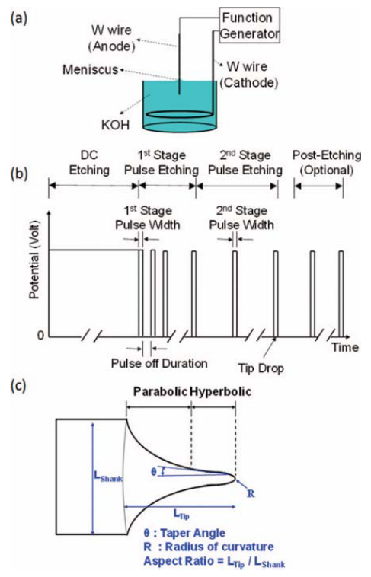
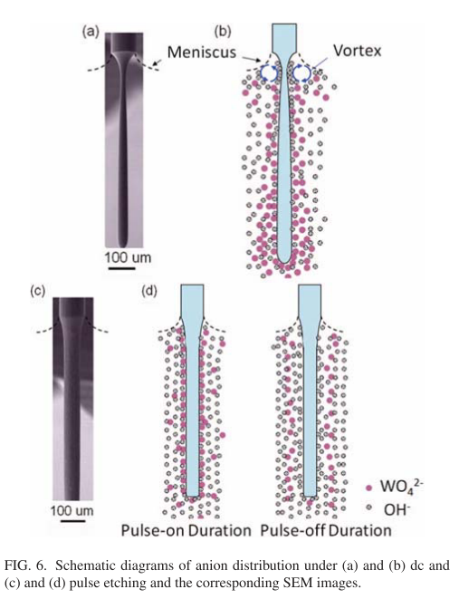
2012-Rev. Sci. Instrum.-83,08374-Method of electrochemical etching of tungsten tips with controllable profiles(Wei-Tse Chang, Ing-Shouh Hwang, Mu-Tung Chang, Chung-Yueh Lin, Wei-Hao Hsu and Jin-Long Hou)
10M
DC(uniform)
etching
“we propose a simple and reliable electrochemical method to fabricate tungsten tips with good control of the tip profile.”
Pulse
etching

Slide 6
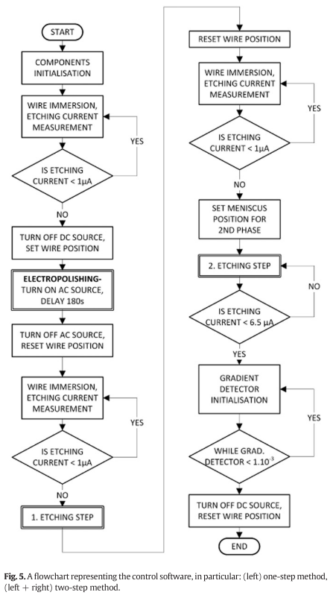
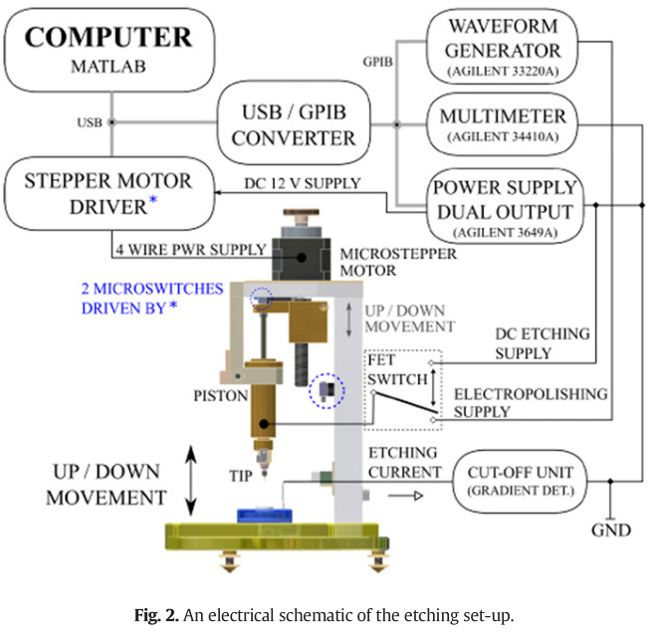
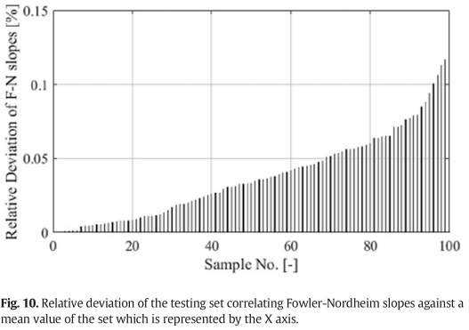
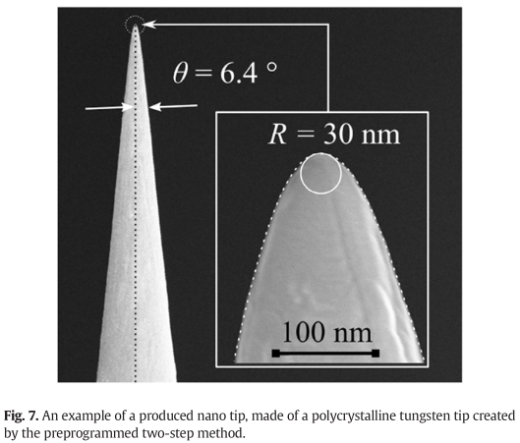
2017-Microelectronic Engineering-173-Progrmmable set-up for electrochemical preparation of STM tips and ultra-sharp field emission cathods(Alexandr Knapek, jiri Sykora, Jana Chlumska, Dinara Sobola)
“The programming allows for increasing the reproducibility of the preparation and improves the quality of the preparation process.”

Slide 7
2007-e-J. Surf. Sci. Nanotech.-5-Dynamic electrochemical etching technique for tungsten tips suitable for multi tip scanning tunneling microscopes(Rei Hobara, Shinya Yoshimoto, Shuji Hasegawa, Katsuyoshi Sakamoto)
“The programming allows for increasing the reproducibility of the preparation and improves the quality of the preparation process.”

Slide 8
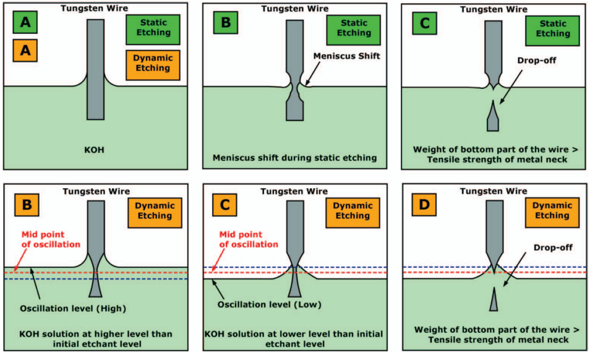
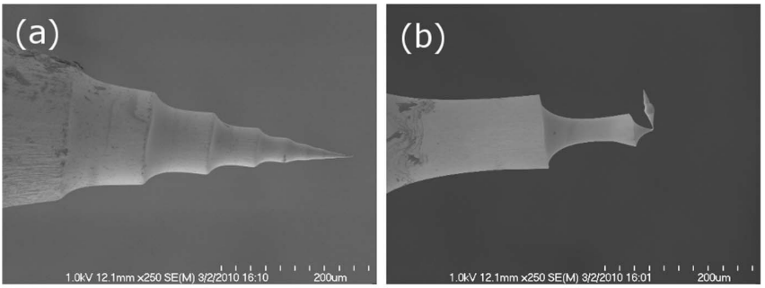
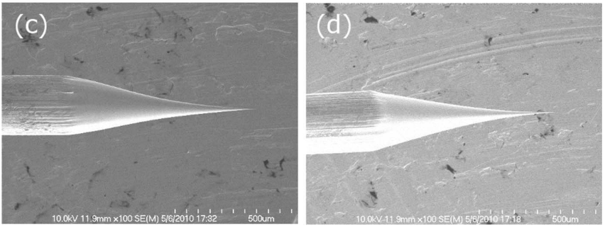
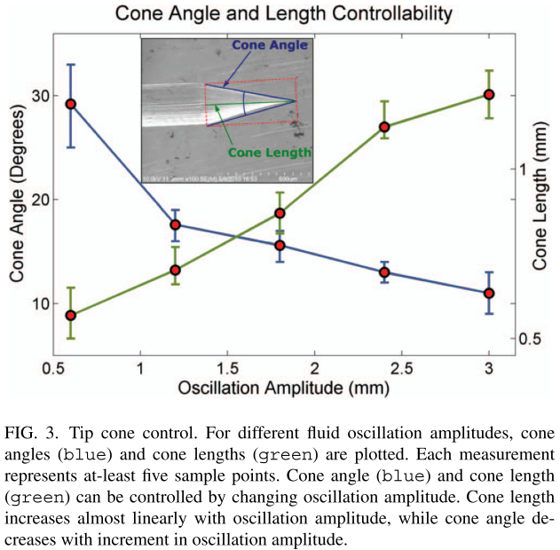
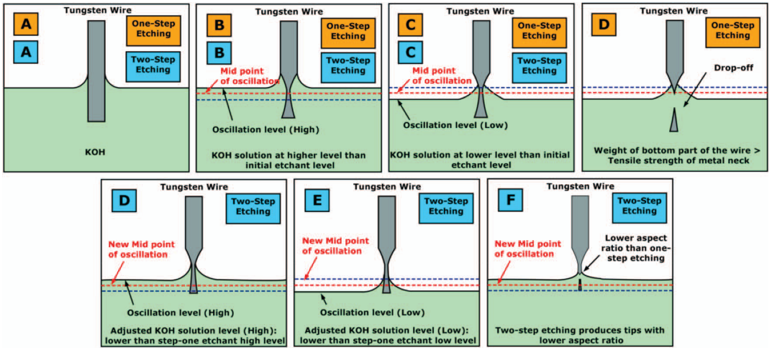
2012-Rev. Sci. Instrum.-83,6-Two step controllable electrochemical etching of tungsten scanning probe microscopy tips(Yasser Khan, Hisham Al-Falih, Yaping Zhang, Tien Khee Ng, Boon S. Ooi)
“The electrolyte solution level remains stagnant throughout the process, the meniscus often moves to a lower level”
Dynamic etching: the electrolyte level is vertically raised and lowered

